Slide 1
Travlendar+
Software Engineering 2 Project, 2017/2018 Politecnico di Milano
Mirko Salaris
Piervincenzo Ventrella
Pietro Cassarino
895394
898604
899152

Slide 2
Use Cases
Sign Up
A General View
An insight on ‘Specify Details’

Slide 3
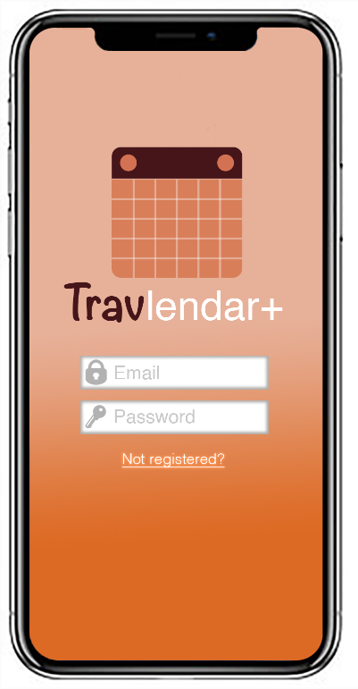
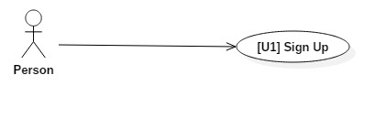
Sign Up
[G1] a Person should be able to have his/her own Travlendar+ agenda

Slide 4
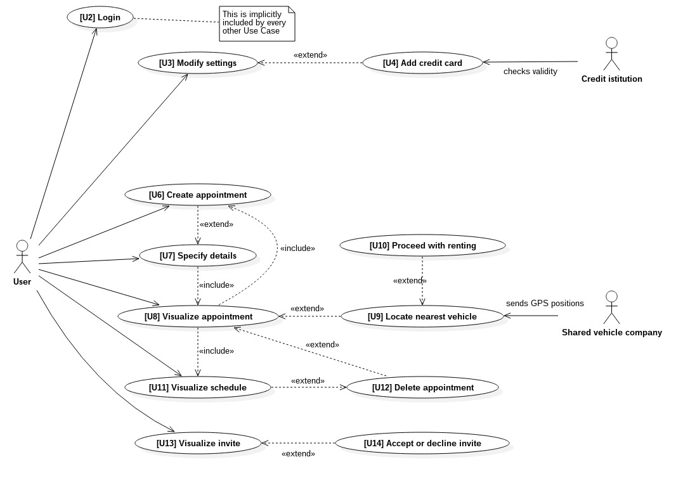
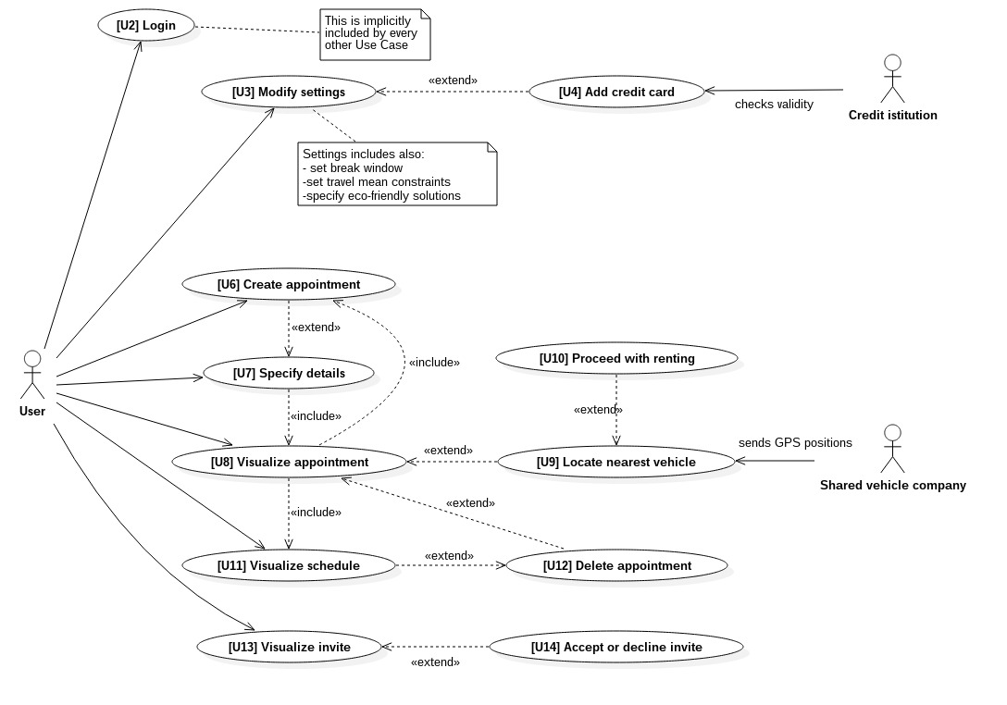
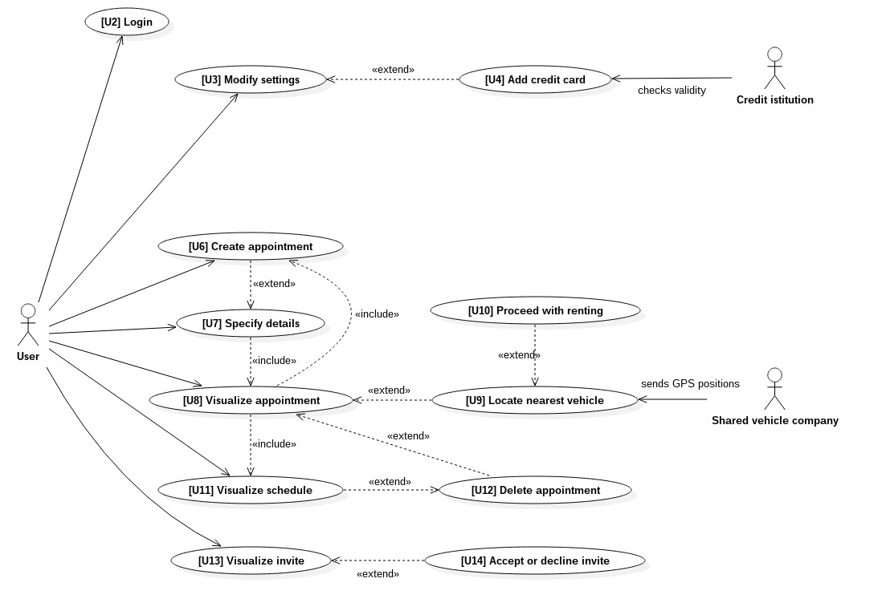
A General View

Slide 5
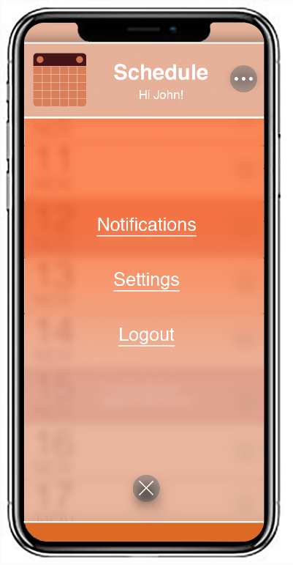
A General View
[G2] a User should be able to customize the offered service
[G2]#1 specify his/her preference for eco-friendly solution
[G2]#2 define break time windows, either flexible or fixed
[G2]#3 define time slot in which the use of specific transportation means should be avoided
[G2]#4 define a minimum distance below which a specific transportation mean should be avoided
[G2]#5 define a maximum distance beyond which a specific transportation mean should be avoided
[G2]#6 disable permanently specific transportation means

Slide 6
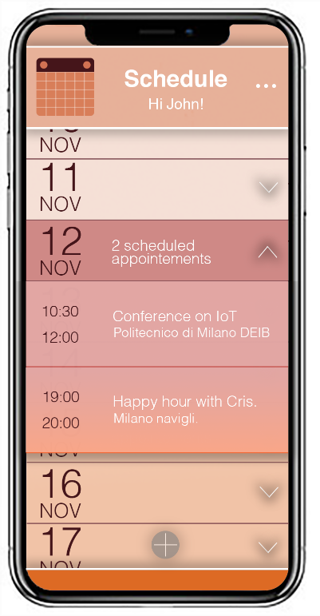
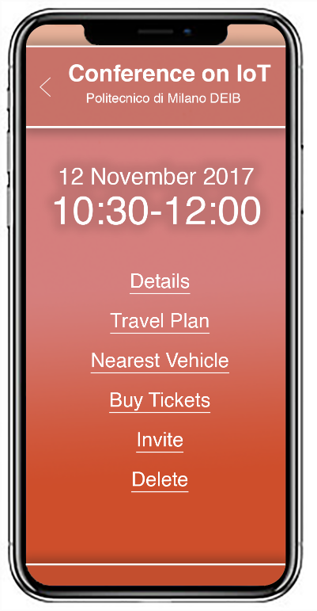
A General View
[G3] a User should be able to take note of all his/her appointments and their details
[G4] a User should be able to manage his/her appointments

Slide 7
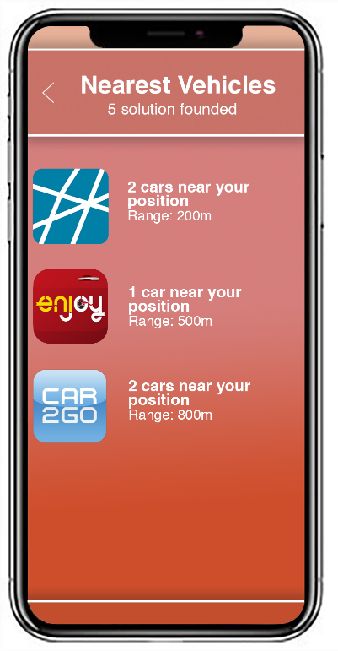
A General View
[G8] a User should be able to locate the nearest vehicle of a vehicle sharing system, if that is the transportation mean of choice of an incoming appointment
[G9] a User should be able to rent a shared vehicle, if that is the transportation mean of choice of an incoming appointment

Slide 8
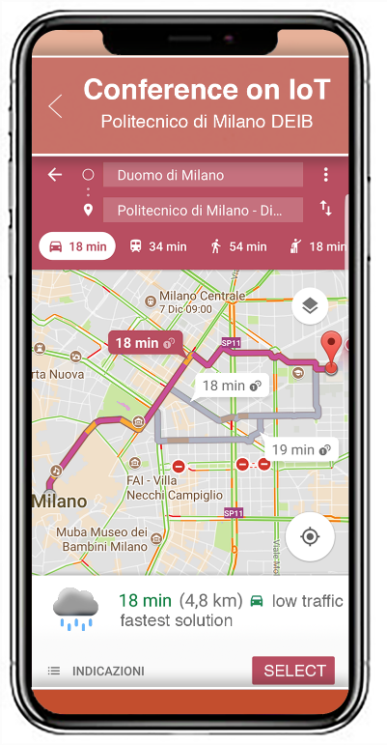
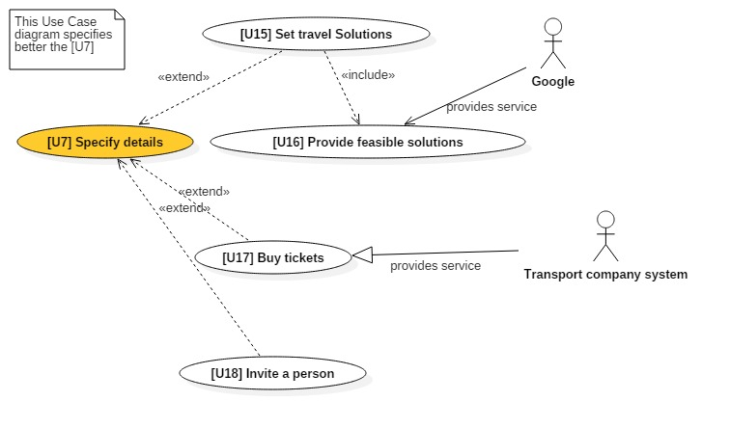
[G5] for each appointment, the User should be assisted in the choice of the travel solution
[G5]#1 travel solution suggestions must take into account traffic, weather conditions/forecast, strikes, type of appointment, baggage, passengers
[G6] a User should be able to invite other persons to his/her appointment
[G7] a User is assisted in the purchase of a ticket when it is required
An insight on ‘Specify Details’

Slide 9
Architecture Overview
Client/server
Service Oriented Architecture
Elastic Components

Slide 10
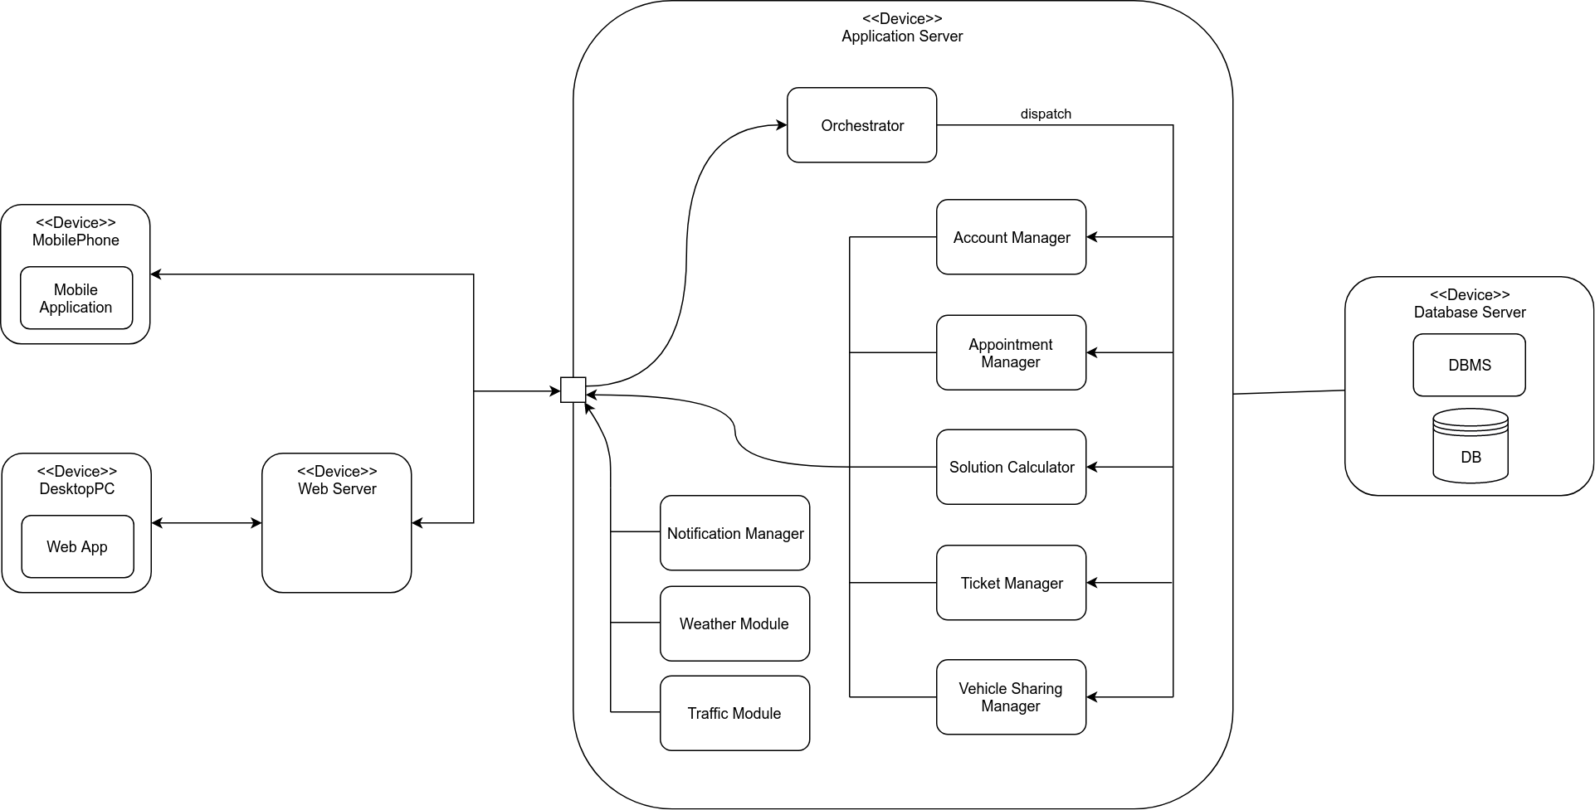
Architecture Overview

Slide 11
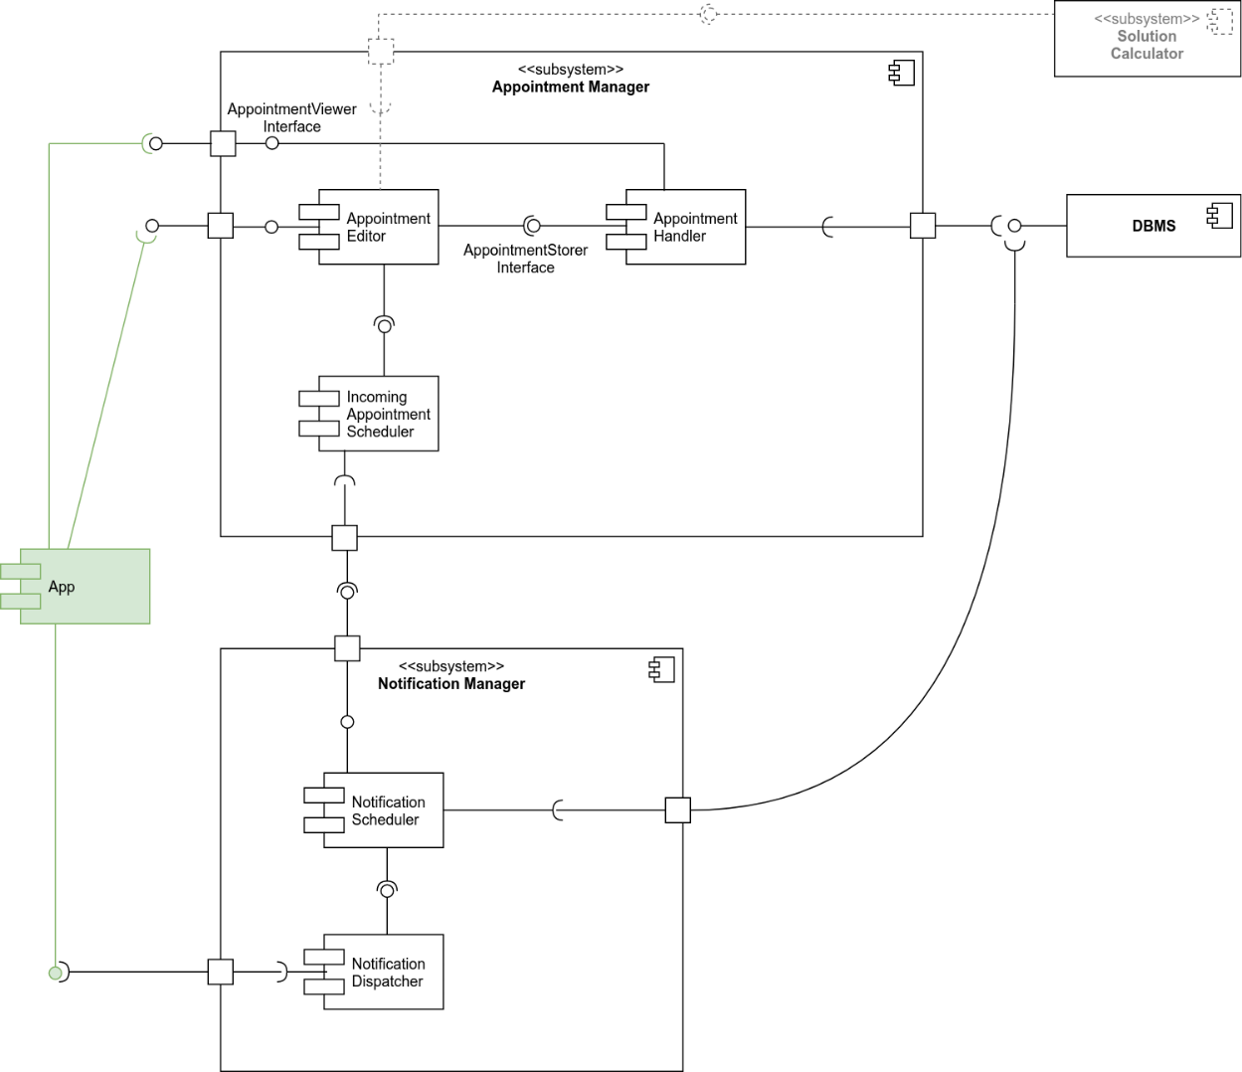

Slide 13
Architecture Overview

Slide 14
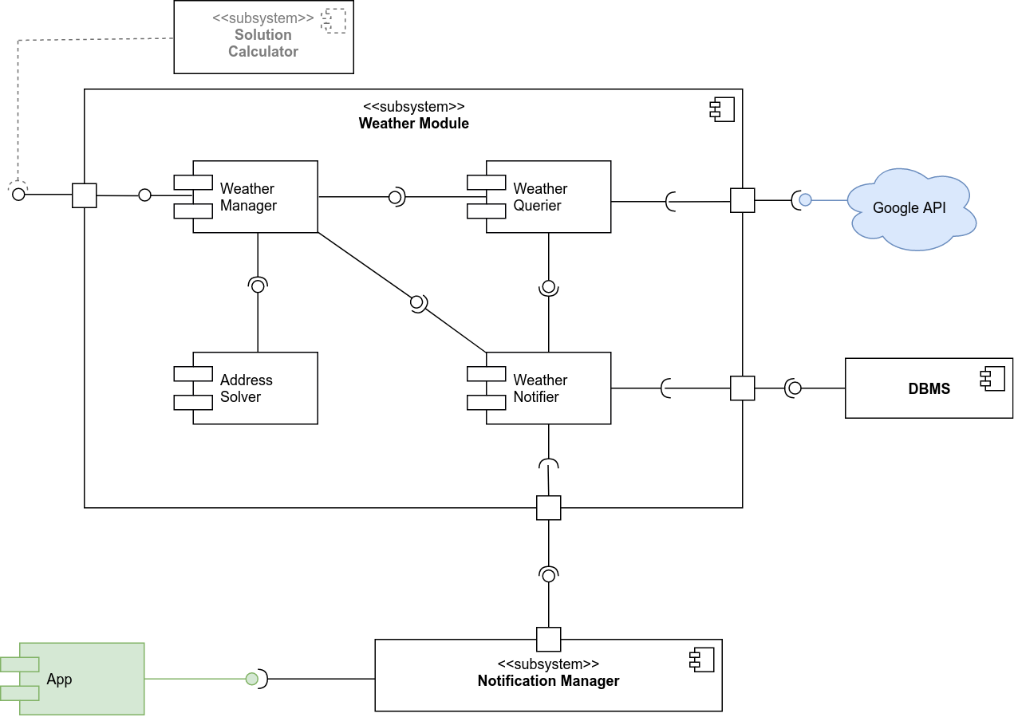

Slide 15
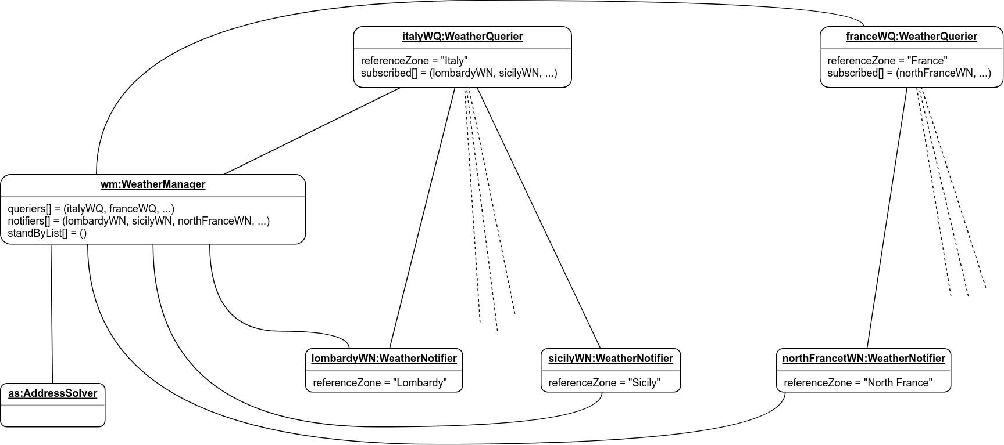

Slide 16
Solution Calculation
Interaction with the user
Overview of the algorithm

Slide 17
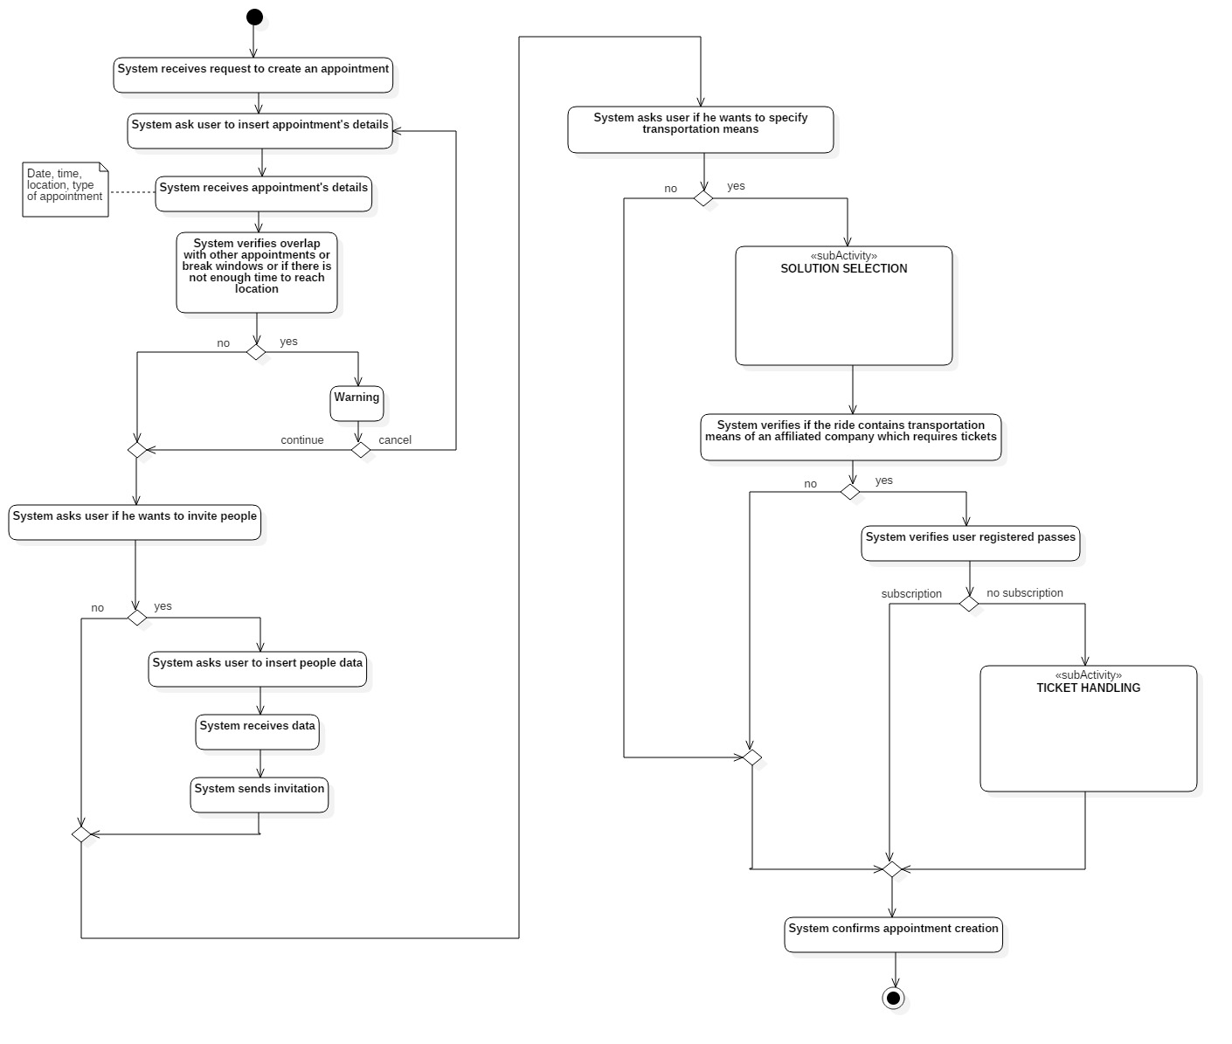
Interaction with the user

Slide 18
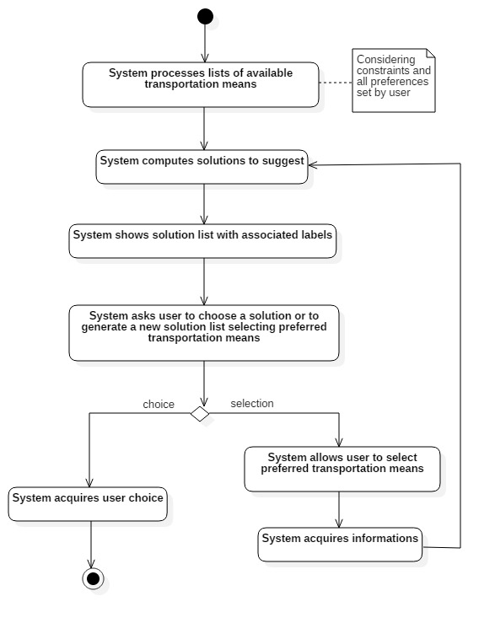

Slide 19
[G2] a User should be able to customize the offered service
[…]
[G2]#3 define time slot in which the use of specific transportation means should be avoided
[G2]#4 define a minimum distance below which a specific transportation mean should be avoided
[G2]#5 define a maximum distance beyond which a specific transportation mean should be avoided
[G2]#6 disable permanently specific transportation means
[G5] for each appointment, the User should be assisted in the choice of the travel solution
[G5]#1 travel solution suggestions must take into account traffic, weather conditions/forecast, strikes, type of appointment, baggage, passengers

Slide 20
Overview of the algorithm

Slide 21
Overview of the algorithm
Retrieval of Feasible TravelPlanSolutions
Filtering
Labeling

Slide 22
Overview of the algorithm
Retrieve appointment information (through Appointment Manager)
interfaces with Google, which provides it with a list of possible travel solutions
Retrieval of Feasible TravelPlanSolutions
Filtering
Labeling

Slide 23
Overview of the algorithm
Retrieval of Feasible TravelPlanSolutions
Retrieve constraints on Travel Means and Eco Friendly preference
Filter out Solutions which contains Ride not compliant with the constraints
Filtering
Labeling

Slide 24
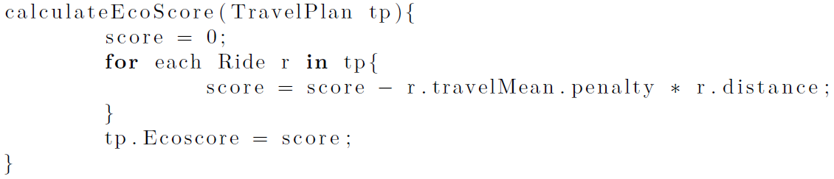
Overview of the algorithm
Retrieval of Feasible TravelPlanSolutions
Filtering
Cheapest TravelPlan
Fastest TravelPlan
Eco-Friendliest TravelPlan
Warning: Weather
Warning: Traffic
Labeling

Slide 25
Travlendar+
Software Engineering 2 Project, 2017/2018 Politecnico di Milano
Mirko Salaris
Piervincenzo Ventrella
Pietro Cassarino
895394
898604
899152

